Slide 1
MIND Project
MIND project - Development of mechatronics skills and innovative learning methods for Industry 4.0
Research. Eng. Victor COBILEAN
This project has been funded with support from the European Commission. This publication [communication] reflects the views only of the authors, and the Commission cannot be held responsible for any use which may be made of the information contained therein.

Slide 2
MIND
Period: 01-09-2019 -31-08-2021
EU Grant: 165803 EUR
Website: https://www.project-mind.eu/
MIND project addresses:
The lack of skills in the field of mechatronics of employees in companies operating in industrial fields that determine the impediment of companies' investments in current technologies, related to Industry 4.0.
The increasing demand for employees with multidisciplinary skills.
The development of mechatronics skills and development of new learning methods to meet Industry 4.0 requirements

Slide 3
The specific objectives of the project
INNOVATION
Determining the mechatronic skills required for Industry 4.0
Increasing the level of student employment in companies that implement Industry 4.0 concepts
Improving the teaching process for didactic staff
Generating collaborations between the private sector and educational institutions

Slide 4
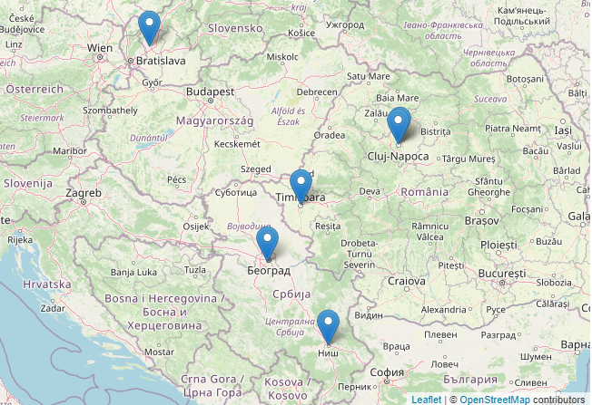
MIND project partners
Technical University of Cluj-Napoca, Romania
Integra HR SRL, Romania
Slovenska Technicka Univerzita V Bratislave, Slovakia
Politehnica University of Timisoara, Romania
Univerzitet U Nisu, Serbia
Coming Computer Engineering d.o.o., Serbia

Slide 5
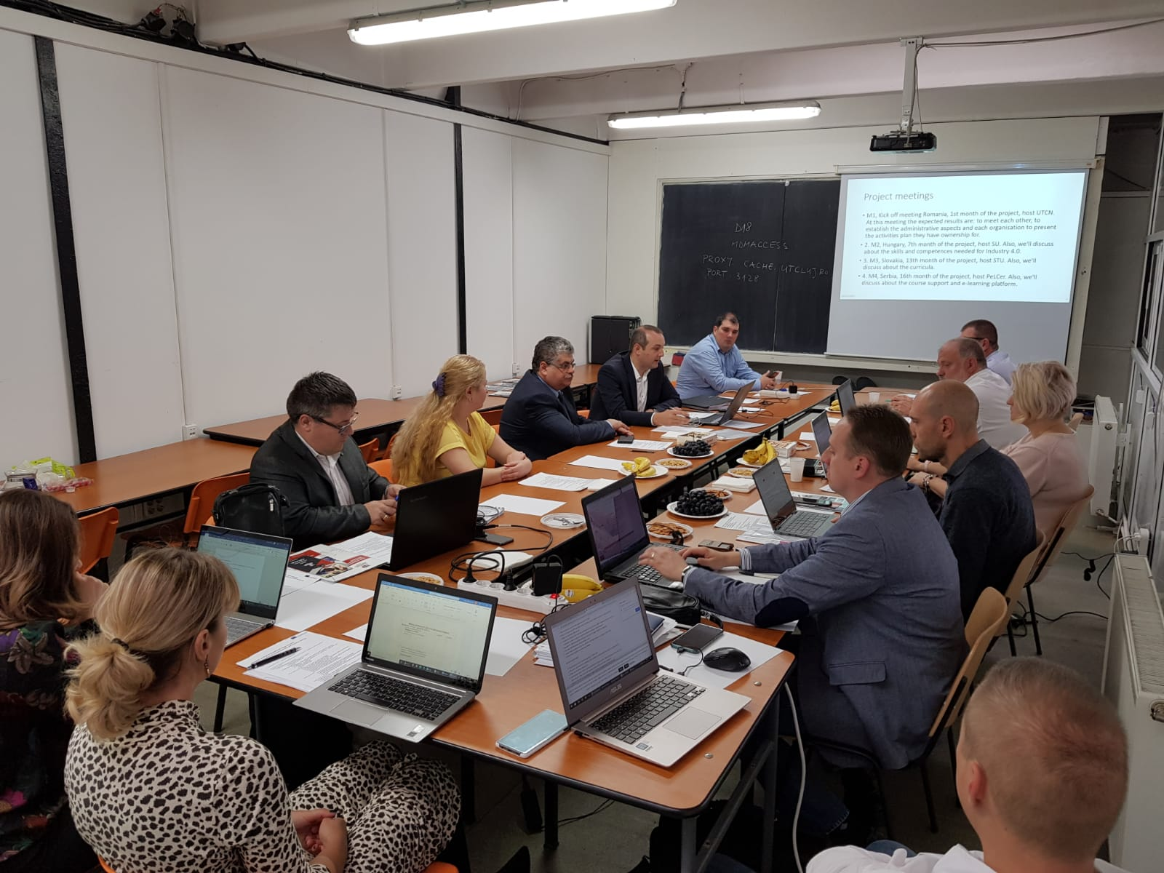
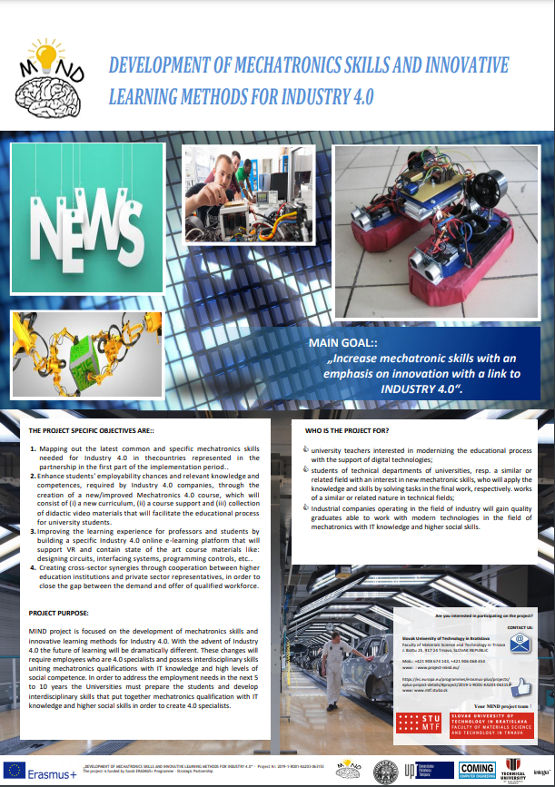
Brief history of the MIND project
Beginning of the MIND project
MIND Project poster
Kick-off meeting, Cluj-Napoca, Romania, 2019

Slide 6
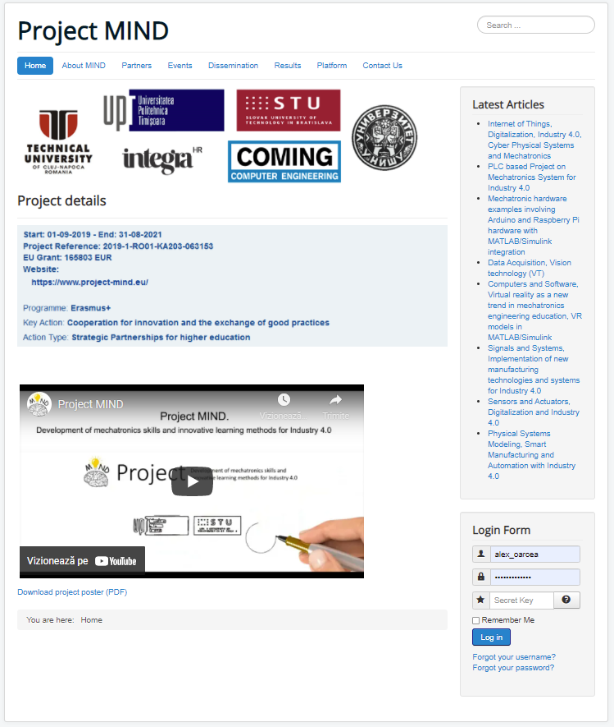
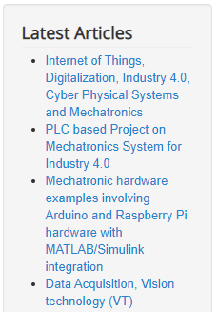
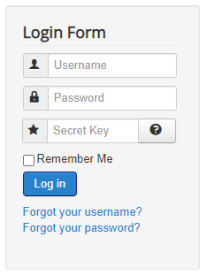
https://www.project-mind.eu/

Slide 8
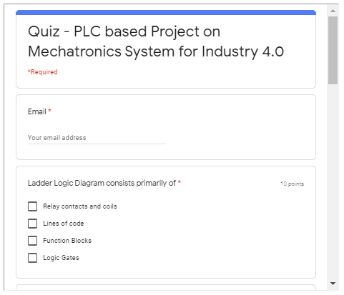

Slide 9
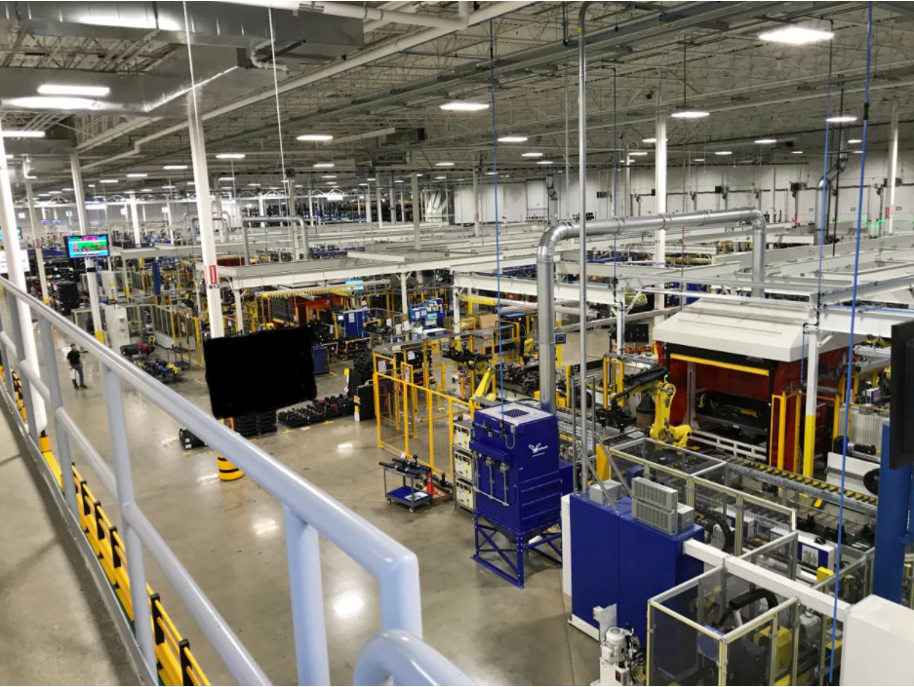
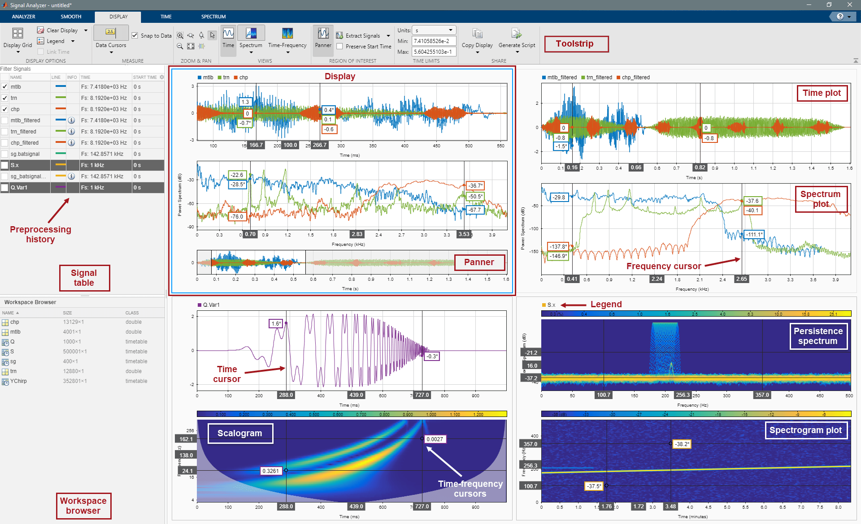
MIND Platform topics:
Physical Systems Modeling, Smart Manufacturing and Automation with Industry 4.0
Signals and Systems, Implementation of new manufacturing technologies and systems for Industry 4.0

Slide 10
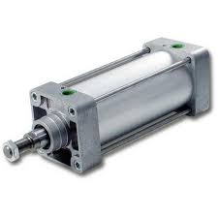
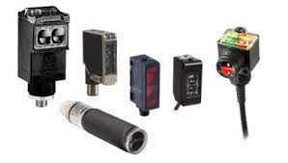
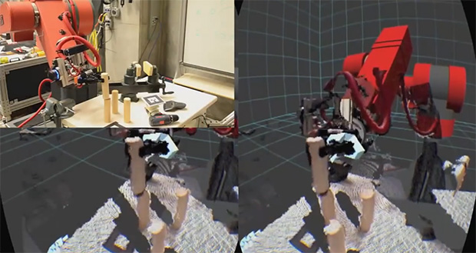
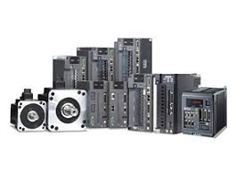
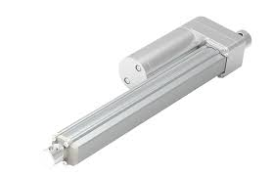
MIND Platform topics:
Sensors and Actuators, Digitalization and Industry 4.0
Virtual reality as a new trend in mechatronics engineering education

Slide 11
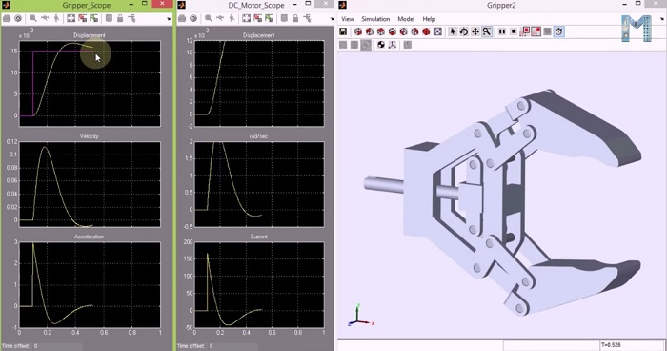
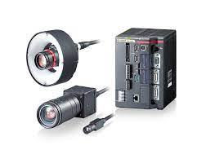
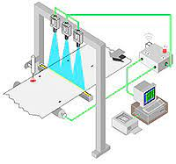
MIND Platform topics:
Data Acquisition, Vision technology (VT)
Mechatronic hardware examples using MATLAB/Simulink

Slide 12
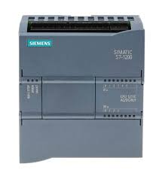
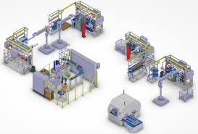
MIND Platform topics:
PLC based Project on Mechatronics System
Internet of Things, Digitalization, Industry 4.0, Cyber Physical Systems and Mechatronics

Slide 13
Classic course
Video MIND
Interactive course
MIND Videos

Slide 14
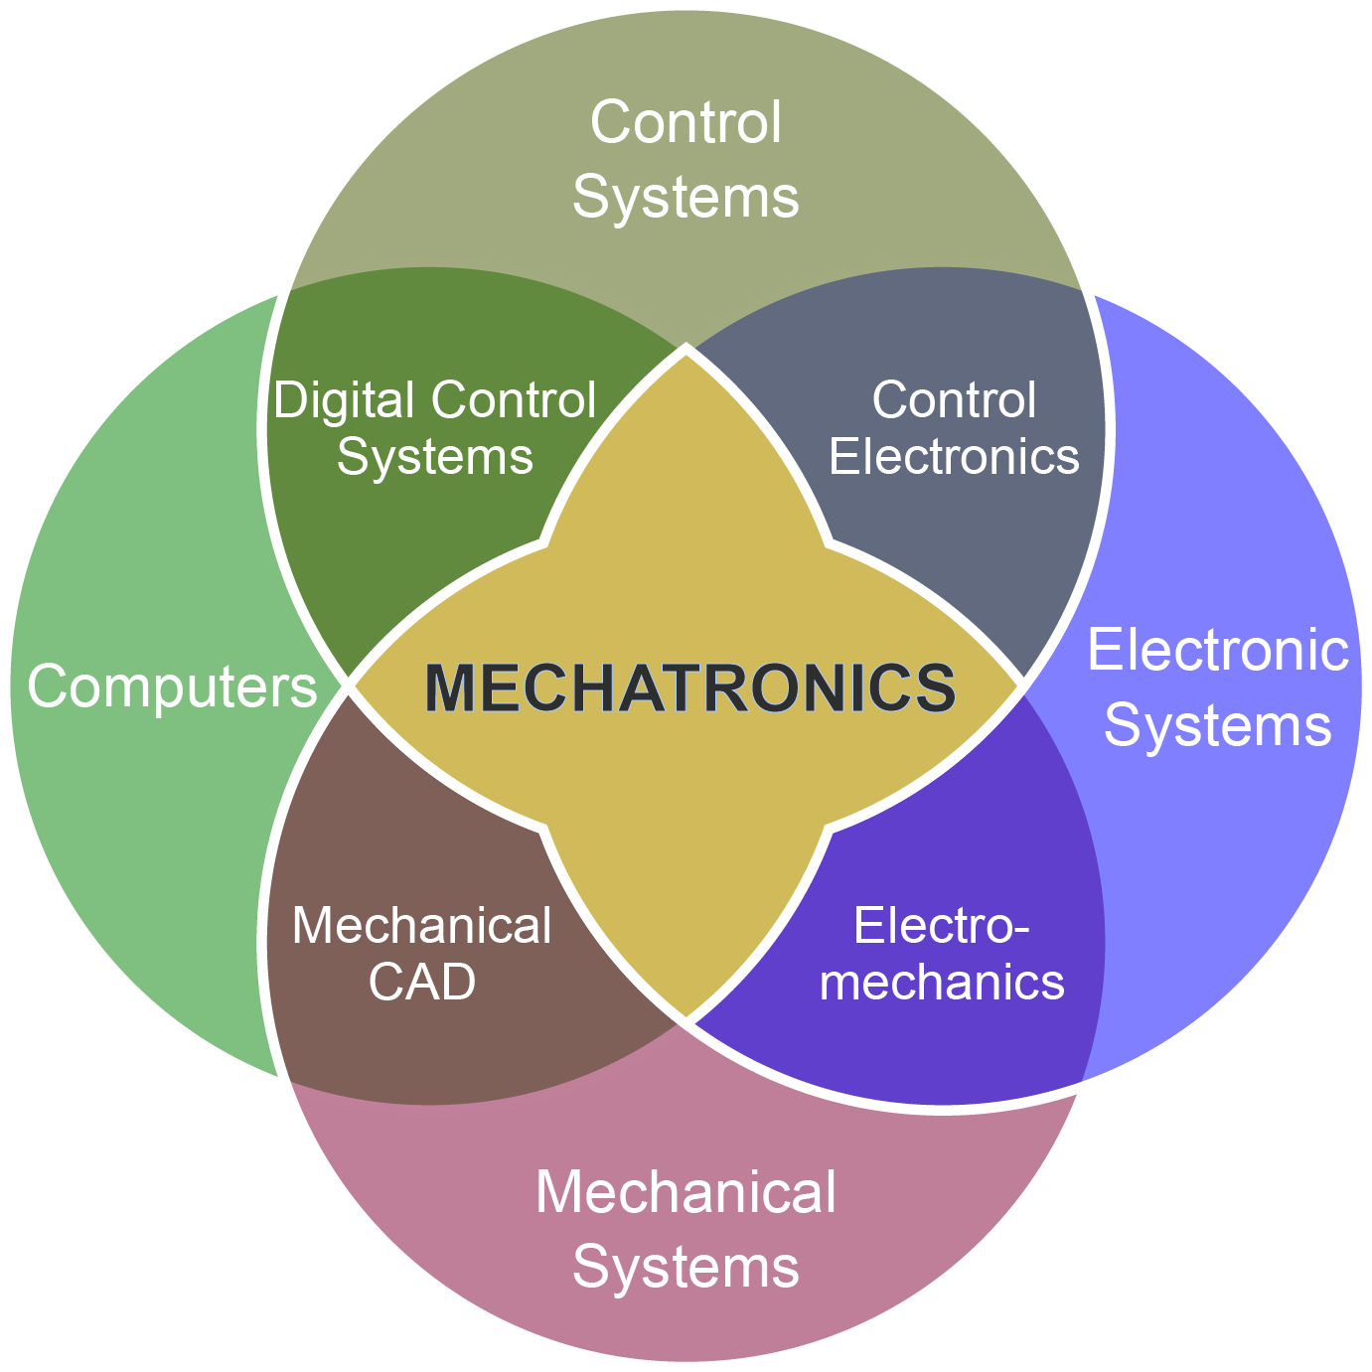
The materials cover the key elements of mechatronics:
Modeling and simulation of mechatronic systems
Sensors and actuators used in mechatronics
Software and data acquisition from sensors
Mechatronic hardware examples involving Arduino and Raspberry Pi hardware

Slide 15
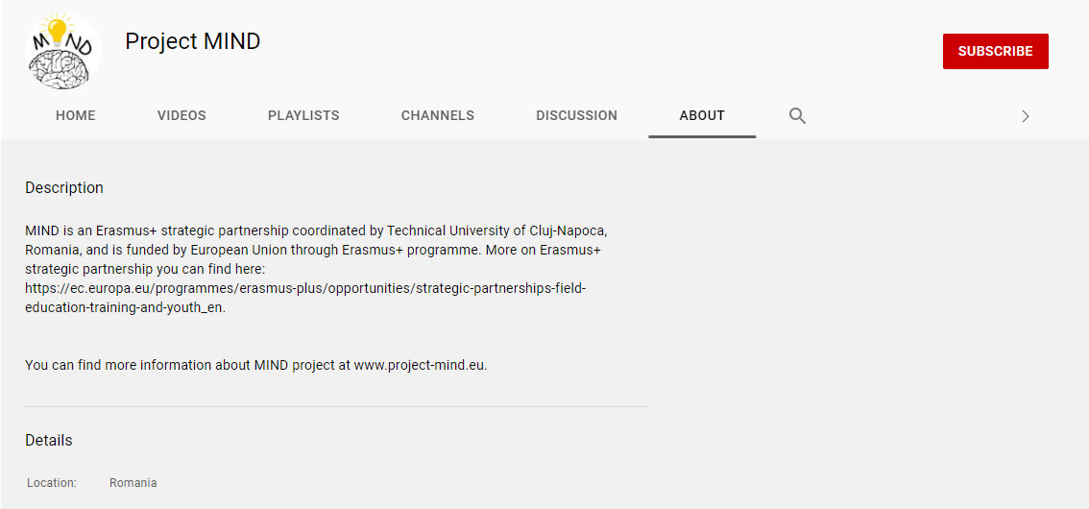
Videos can be accessed:
https://www.project-mind.eu/index.php/platform

Slide 16
In conclusion, Project MIND reached following achievements:
Developing of a platform for self-teaching of new trends in mechatronics.
Development of networks of partnerships between companies and universities via Multiplier Events.
Development of a new educational program (entitled Mechatronics 4.0).

Slide 17
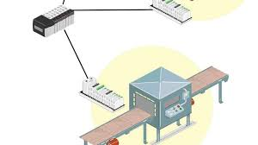
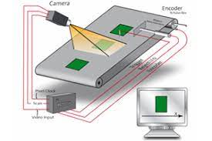
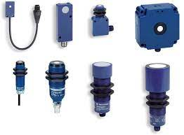
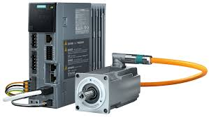
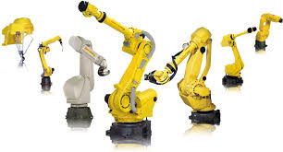
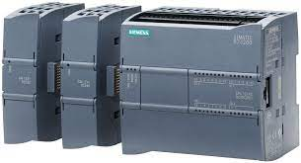
Thank you for your attention!

